Slide 1




LIOProf: Exposing Lustre File System
Behavior for I/O Middleware
Cong Xu, Vishwanath Venkatesan,
Omkar Kulkarni, Kalyana Chadalavada
Intel Corporation
Suren Byna
Lawrence Berkeley National Laboratory
Robert Sisneros
National Center for Supercomputing Applications
Mohamad Chaarawi
The HDF5 Group

Slide 2
Outline
Background and Introduction
Motivation
LIOProf Design and Implementation
Two Case Studies
  Improve MPI-IO Performance over Lustre
  Address Parallel HDF5 Overhead
Conclusion

Slide 3
I/O System and Profiling Tools
Parallel I/O subsystem is complex
  Levels of software stacks, hardware layers, various I/O patterns
  Detecting performance bottleneck is challenging
Address the challenge: profiling tools
  Facilitate I/O characterization for I/O activities analysis
  Existing profiling tools: Darshan, Lustre Monitoring Tool (LMT)
Application
HDF5/NetCDF
MPI-IO
Lustre File System
Backend Disks
Parallel I/O Stacks

Slide 4
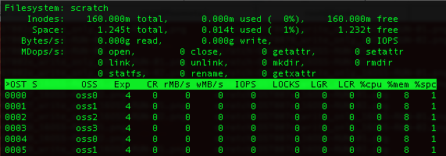
Issues in Legacy Lustre Profiling Tools
Limited I/O tracing information
  CPU utilization, Memory usage and Disk bandwidth etc.
Missing correlation info between Lustre clients and servers
  Need to uncover how application I/O requests correlate with file system activities
  Lustre RPC traces provide us this information
Lustre Monitoring Tool Snapshot

Slide 5
Lustre RPC Tracing
Analyze Lustre RPC trace logs
  Clients I/O Requests on OSS nodes
  I/O workload distribution
  Lock Contention
Client0
Client1
Client2
Read at time 0:12
Read at time 0:25
MDS
Read at time 0:12
Read at time 0:06
MDT
OSS0
OSS1
OST0
OST1
Lustre RPC trace logs | OSS0 | OSS1
Clients I/O Requests on each OSS Node | Handle Client0 Read at 0:12 Handle Client1 Read at 0:12 | Handle Client0 Read at 0:06 Handle Client2 Read at 0:25
… | … | …

Slide 6
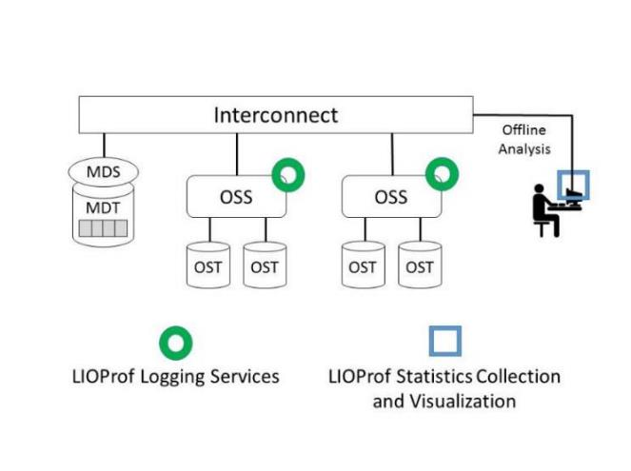
LIOProf: Lustre IO Profiler
Logging Services
  Enable RPC tracing to record the I/O activities of OSS nodes
  Available to super users / administrators
Statistics Collection and Visualization
  Collect the statistical metrics and generate visualization plots
  Logs can be parsed offline
LIOProf Components

Slide 7
LIOProf Logging Services
Enable Lustre RPC (Remote Procedure Call) Tracing
  Configure parameter “debug” to be rpctrace log level
  Employ debug buffer to store RPC tracing logs in memory
  Launch background debug_daemon to drain the logs
Overhead of LIOProf Logging Services
  Compare the efficiency of Benchmarks with/without enabling the LIOProf
  The performance difference is less than 1%

Slide 8
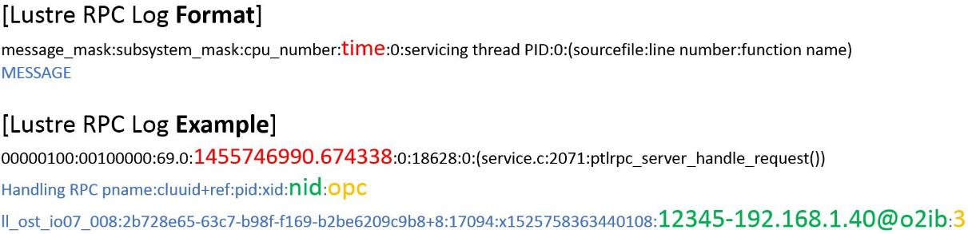
LIOProf Statistics Collection and Visualization
Parse RPC traces for I/O activities information
  Log item time: time that the request has been handled
  RPC source: client that issues the request
  RPC operation code(opc): request type
I/O statistics visualization
  Gather and organize the parsed output
  Create the gnuplot script for visualization

Slide 9
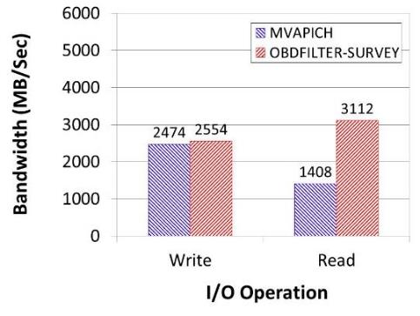
Case 1: Investigate MPIIO Performance over Lustre
IOR Benchmark with MPI-IO API on Wolf Cluster
  192 processes perform concurrent I/O in an interleaved access pattern on shared file
  IOR Config [FileSize: 768GB, BlockSize: 4MB, TransferSize: 4MB, Aggregators: 4]
  Lustre Config [4 OSTs, 6 Clients, Stripe Size: 4MB, Stripe Count: 4]
Obdfilter-survey is employed to measure the maximum available bandwidth
MVAPICH read operation performs 54.8% worse than obdfilter-survey
Overall Performance of MVAPICH

Slide 10
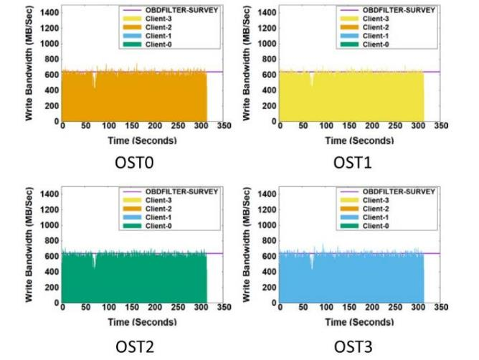
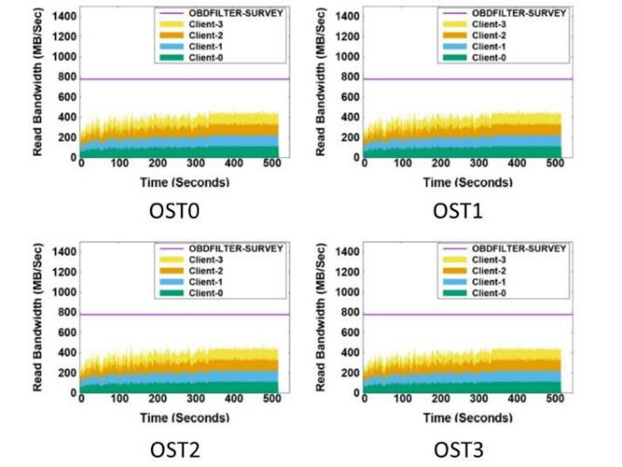
Use LIOProf to Analyze Server I/O Bandwidth
Each OST is able to deliver maximum available write bandwidth
Read bandwidth is distributed to 4 aggregators on clients
  However, the aggregated bandwidth is lower than maximum bandwidth
  MVAPICH cannot obtain Lustre Stripe Info, each aggregator reads from multiple OSTs
Write
Read

Slide 11
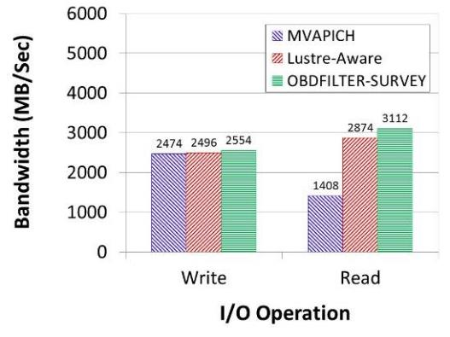
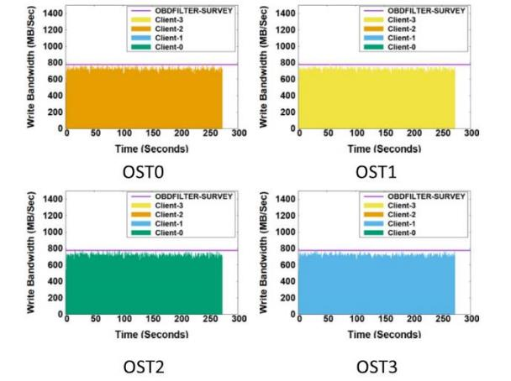
Lustre-Aware CB (Collective Buffer) Read Algorithm
  Obtain Lustre Stripe Info, each aggregator reads from one OST
Lustre-Aware read algorithm delivers near optimal bandwidth
  Lustre-Aware performs 104% better than original MVAPICH
  Each OST serves I/O requests at high ratio
Overall Performance of
Lustre-Aware CB Algorithm
Lustre-Aware Read

Slide 12
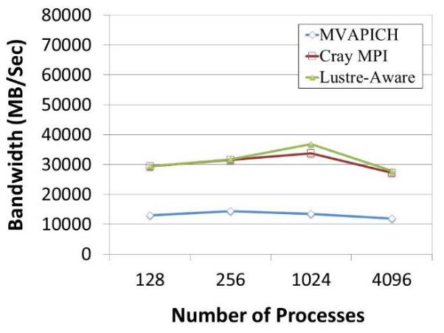
Lustre-Aware CB Read Performance on Cori System
Use IOR to launch 128 to 4096 processes on 128 Lustre Clients
Read 16TB data from 96 Lustre OSTs
Lustre-Aware performs 134% better than MVAPICH at 4096 Processes
Read Performance on Cori System

Slide 13
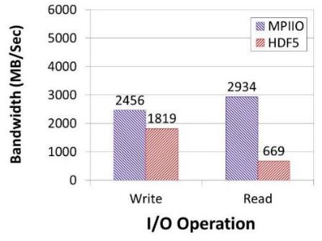
Case 2: Measure Parallel HDF5 Overhead
After optimization, MPIIO achieves maximum bandwidth
IOR benchmark with HDF5 and MPIIO APIs
  4 Processes perform I/O in an interleaved access pattern on shared file
  IOR Config [FileSize: 512GB, BlockSize: 4MB, TransferSize: 4MB, Aggregators: 4]
  Lustre Config [4 OSTs, 4 Clients, Stripe Size: 4MB, Stripe Count: 4]
HDF5 performs worse than MPIIO, especially in read operation
Comparison between MPIIO and HDF5

Slide 14
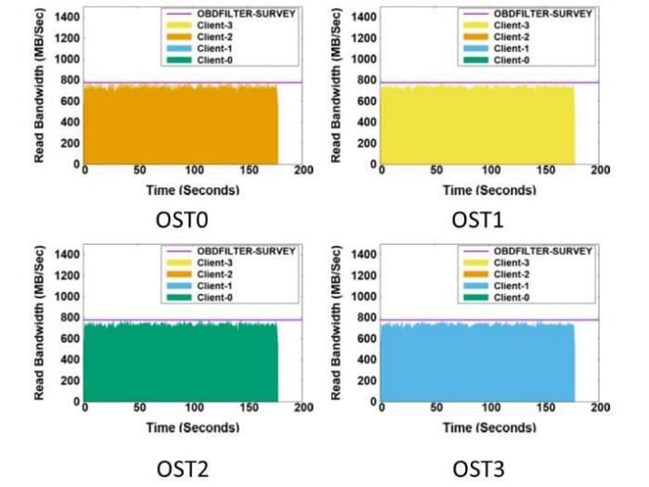
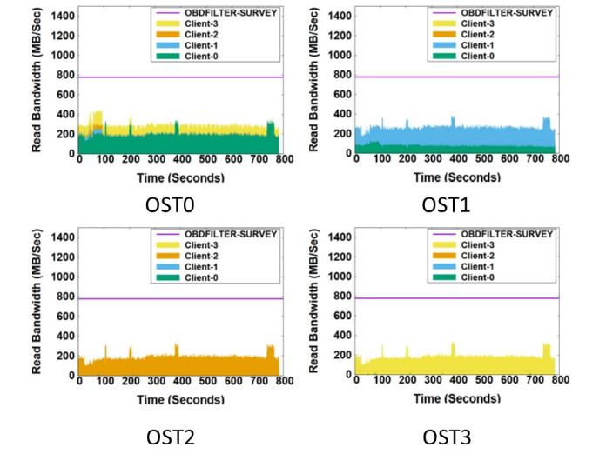
Using LIOProf to Reveal HDF5 I/O Activities in Read
OSTs deliver high bandwidth constantly in MPIIO case
In HDF5 case, each OST services both datasets and metadata I/O requests
HDF5 metadata operations affect datasets I/O accesses
MPIIO
HDF5

Slide 15
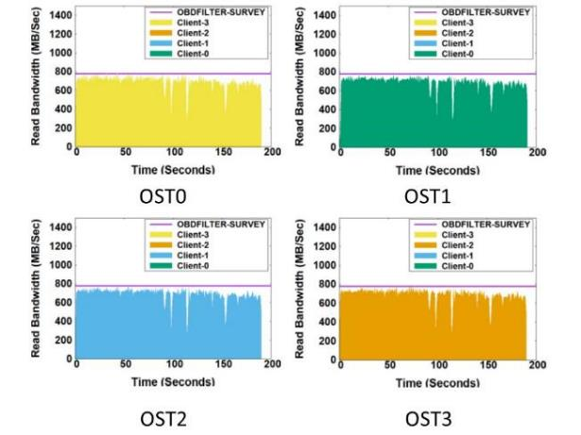
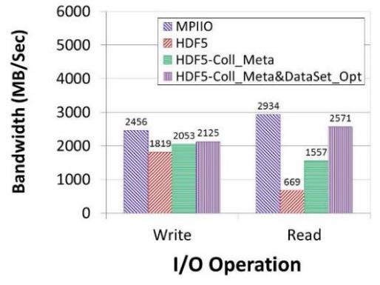
HDF5 Collective Metadata and Datasets Optimizations
Enable HDF5 Collective Metadata write/read in IOR
Additionally, open all the datasets in the beginning, cache datasets metadata in memory
HDF5-Coll_Meta&DataSet_Opt outperforms HDF5 and HDF5-Coll_Meta by 175.3% and 65.1% in read
  The overhead of metadata operations have been reduced significantly
Overall Performance with Both
Collective Metadata and Datasets Optimizations
HDF5-Coll_Meta&DataSet_Opt

Slide 16
Conclusion
Propose Lustre IO Profiler, called LIOProf, to track the I/O activities on Lustre Server
LIOProf is useful in uncovering correlation info between I/O patterns and Lustre behavior
Leverage LIOProf in two case studies
  Case 1: Design and implement Lustre-aware Collective Buffer Read Algorithm
  Case 2: Identify HDF5 overhead and improve its performance

Slide 17

Thank You and Questions

Slide 18
Two Case Studies with LIOProf
Case 1: Investigate MPI-IO performance over Lustre
  Identify issue in MVAPICH read algorithm over Lustre
  Implement Lustre-Aware CB (Collective Buffer) Read Algorithm
Case 2: Measure Parallel HDF5 overhead
  Observe considerable performance gap between HDF5 and MPI-IO cases
  Address the HDF5 overhead through enabling collective metadata and applying datasets optimization

Slide 19
Evaluation Environment
Wolf Cluster
  Each node equips 64GB Memory, 36 CPU Cores
  Nodes are connected by Mellanox ConnectX QDR IB
Cori Supercomputer
  1,630 compute nodes with 30PB Lustre storage
  32 CPU Cores and 128GB Memory per node
  Cray Aries high-speed interconnect with Dragonfly topology
Software Configuration
  IOR Benchmark MPIIO and HDF5 APIs
  MVAPICH2-2.2b, Lustre version 2.7
  HDF5-1.9.234(Parallel)

Slide 20
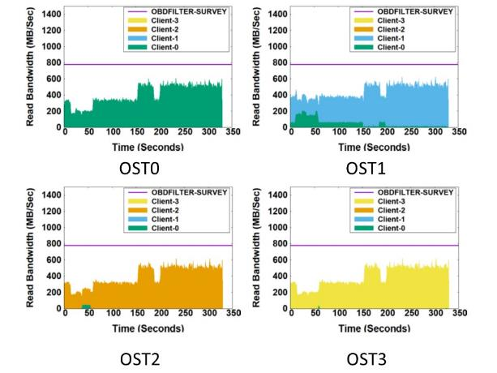
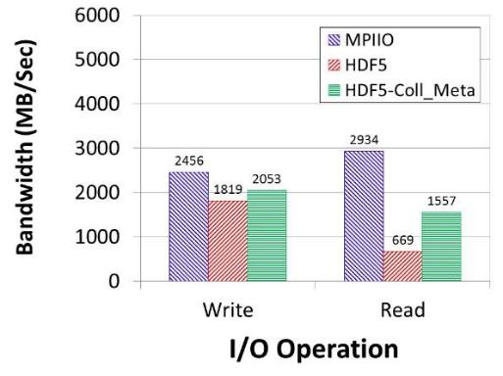
Optimize HDF5 by Collective Metadata Operation
Enable HDF5 Collective Metadata write/read in IOR
  H5Pset_coll_metadata_write() & H5Pset_all_coll_metadata_ops()
  Collective Metadata Read: one process reads metadata and broadcasts
HDF5-Coll_Meta delivers 175.3% higher read bandwidth than HDF5
Overall Performance with
Collective Metadata Optimization
I/O Activities in Read Operation

